Slide 1
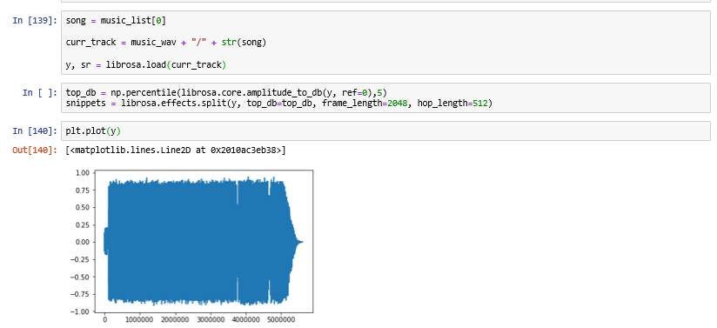

Slide 2
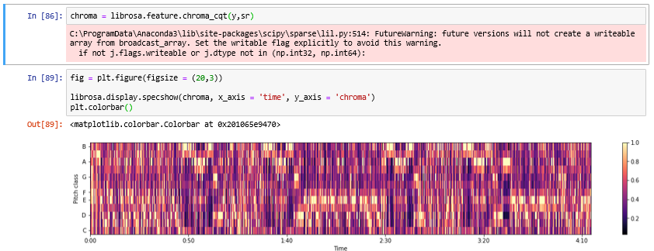

Slide 3
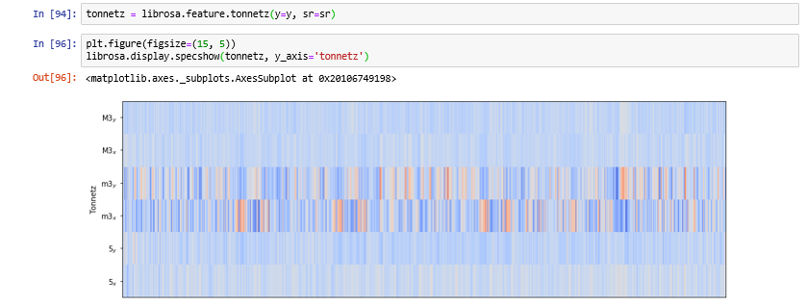

Slide 4
Embed code
<html><head>
<!-- Load require.js. Delete this if your page already loads require.js -->
<script src="https://cdnjs.cloudflare.com/ajax/libs/require.js/2.3.4/require.min.js" integrity="sha256-Ae2Vz/4ePdIu6ZyI/5ZGsYnb+m0JlOmKPjt6XZ9JJkA=" crossorigin="anonymous"></script>
<script src="https://unpkg.com/@jupyter-widgets/html-manager@*/dist/embed-amd.js" crossorigin="anonymous"></script>
<script type="application/vnd.jupyter.widget-state+json">
{
"version_major": 2,
"version_minor": 0,
"state": {}
}
</script>
</head>
<body>
</body>
</html>

